Slide 1
Project Statistical Study
Name
Institution

Slide 2
Executive Summary
Introduction
Data review
Univariate analysis
Bivariate analysis
Limitations

Slide 3
Objective and Introduction
Objective
Exploratory analysis of Asian restaurants in Central/Southern New Hampshire
Introduction
Exploratory analysis will help us get insights, It will also help us discover trends in the data.

Slide 4
Dataset
The dataset has 103 records of Asian restaurants.
The dataset has 13 variables, 12 are quantitative variables and 1 is a categorical variable.
Variables that will be used in the analysis are price, google reviews, google rating, doordash reviews, doordash rating, yelp reviews, yelp rating, and town.

Slide 5
Analysis and Discussion
Descriptive Statistics
The mean reviews given to the restaurants was 273.81.
The maximum review given is 1135
The highest rated restaurant was rated 4.9
The lowest rated restaurant was rated 2.7
Most restaurants are located in Manchester town

Slide 6
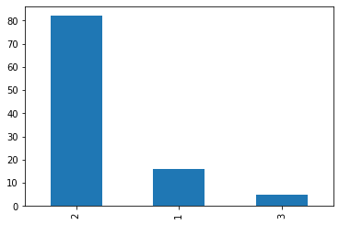
Univariate Objective 1: Price
The graph shows the distribution of price among the restaurants. Most restaurants have a price of category 2 which is $10-$30.

Slide 7
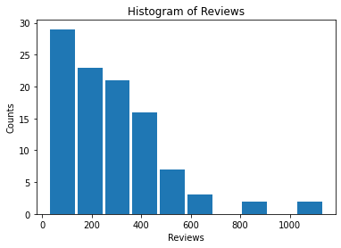
Univariate Objective 2: Google Reviews
The graph shows the distribution of the Google reviews for the restaurants. Most restaurants have less than 400 reviews.

Slide 8
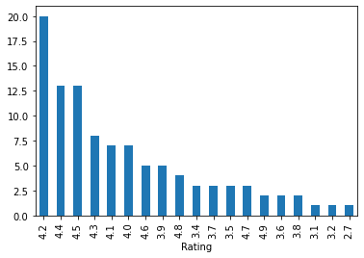
Univariate Objective 3: Google Rating
The graph shows the distribution of google ratings for the restaurants. The trend shows that most restaurants had a rating between 4.0 – 4.5.

Slide 9
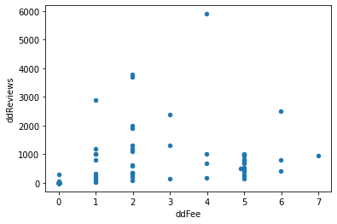
Bivariate Objective 1: Doordash fee
For bivariate analysis we analyzed correlation between door dash fee and door dash reviews. The correlation coefficient was 0.41 which shows a moderate positive correlation. A scatterplot was plotted to show the correlation.

Slide 10
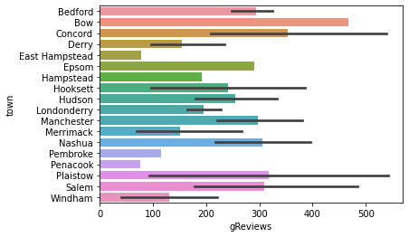
Bivariate Objective 2: Restaurant location
We looked at the bivariate relationship between google reviews and restaurant location. We plotted a bar graph to show the distribution between reviews and town.

Slide 11
Limitations
The data did not have enough variables to provide enough information about the restaurants. To mitigate this we need to collect more data about the restaurants.
The data collected was only for New Hampshire. To mitigate this we should increase the scope of our study to a whole state or country.

